Slide 1




Technical Assistance to
SSATP Pillar 4: Resilient Road Asset Management (RRAM)
Jose Cordovilla – TA Team Leader, TYPSA
18 September 2025
EC-INTPA/2024/EARP/0021

Slide 2
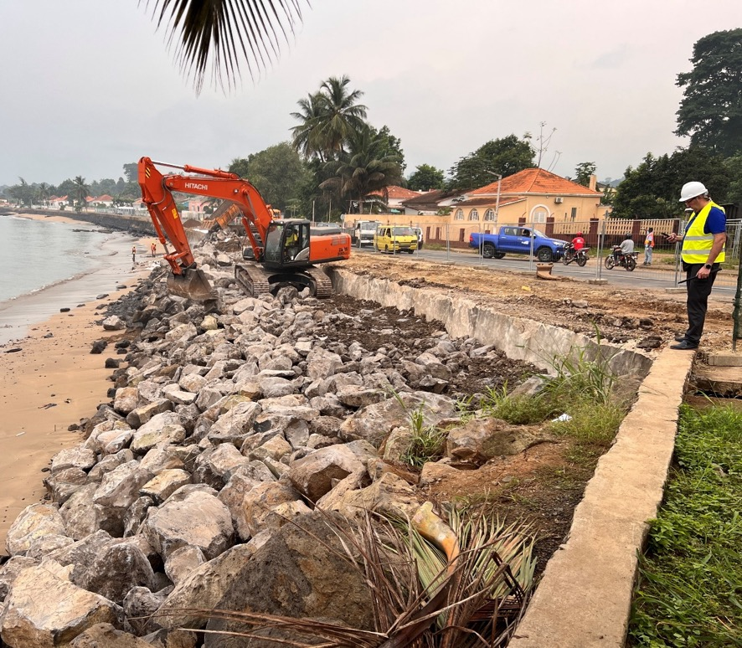
Contents
Background to the Contract & SSATP Pillar 4 – RRAM
Technical Assistance Team
Objectives of the RF Baseline Study
Timeline & ARMFA collaboration
Agua Grande Coastal Protection and Reconstruction of the Marginal Road in Sao Tome and Principe. Source: TYPSA

Slide 3
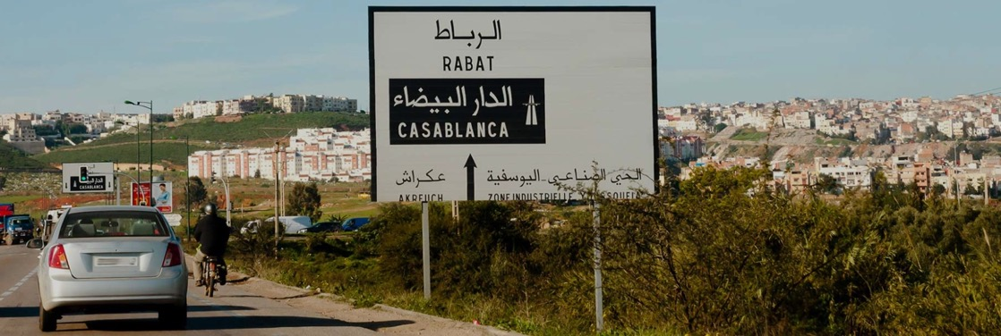
1
Background
Road maintenance strategies for Morocco’s rural roads network . Source: TYPSA

Slide 4
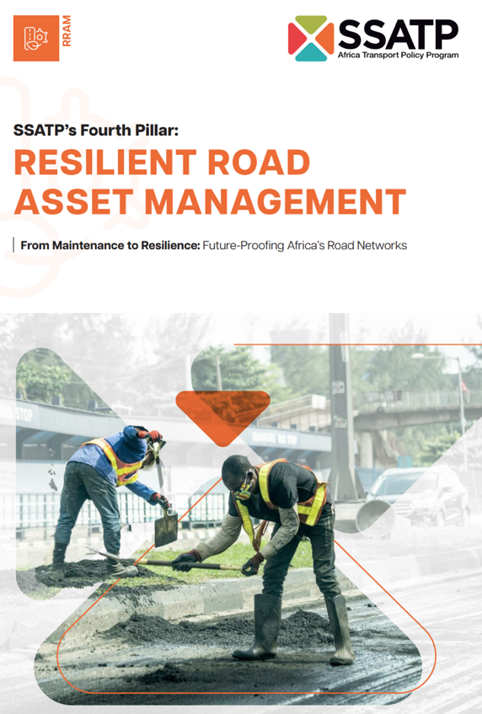
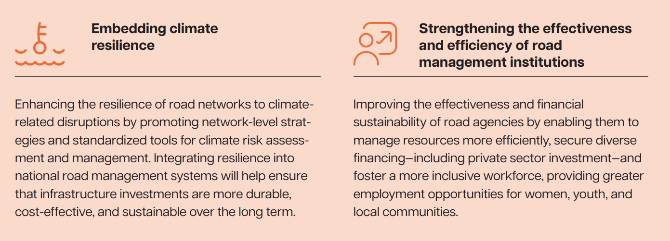
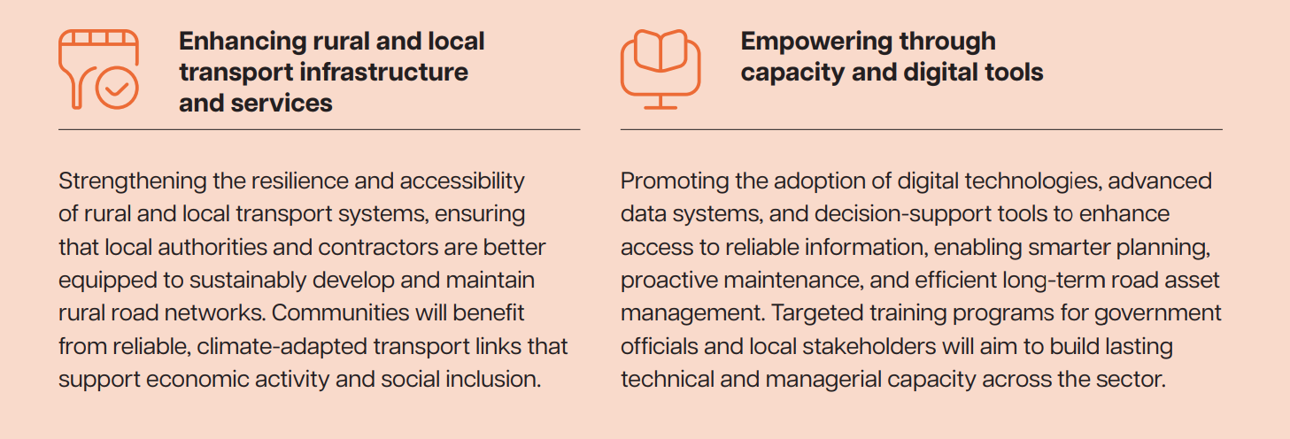
Technical Assistance to SSATP

Slide 5
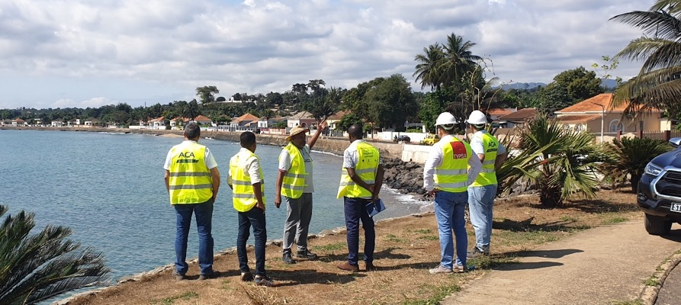
2
Technical Assistance Team
Agua Grande Coastal Protection and Reconstruction of the Marginal Road in Sao Tome and Principe. Source: TYPSA

Slide 6


Technical Assistance Team
TYPSA has been working in Africa for more than 40 years. Successfully implemented >200 projects, particularly in roads: feasibility studies, design, tender documents, TAs, technical audits and evaluations and developing projects related to climate change and resilience
Specialized in Road Asset Management, has been advising public and private administrations for >20 years to manage roads sustainably. ICARO RAMS has been implemented on more than 250,000 km of paved and unpaved roads around the world. Experience in Africa covers Guinea, Madagascar, Morocco and Tunisia
Based in Brussels, it has 65 years of experience in design and implementation of international co-operation programs and projects financed by the European Union, the World Bank and other IFIs Extensive track record in TAs with the European Commission in Africa, mainly on rural development and climate change.

Slide 7


Team (iii) Key Experts
TEAM LEADER - SENIOR TRANSPORT SPECIALIST
SENIOR ENVIRONMENT / CLIMATE SPECIALIST
Jose Cordovilla: Transport Economist and Urban Planner with over 25 years experience in transport sector projects involving road infrastructure, public transport, road asset management, PPPs, capacity building and technical assistance.
Enrique Piñero: environmental expert with over 34 years of experience in the infrastructure projects in Africa, Asia, Europe, and the Middle East. His expertise focuses on integrating environmental and climate aspects into the planning, supervision, and auditing of civil works.
Sid Boubekeur: Senior Finance and Private Sector Development Expert with over 25 years of experience in EU-funded programs across Africa, the Caribbean, and the Pacific. Specialized in transport reforms, sector competitiveness, investment and trade facilitation with a strong focus on women and youth, ESG integration, and public-private dialogue
Maurice Niaty-Mouamba: Transport Economist and Engineer-Economist with more than 40 years of international experience in transport policy, infrastructure planning, and regional integration. Former Minister of Transport of Congo and senior advisor at the African Union Commission, with leadership roles in developing PIDA, SSATP, and road, rail, and aviation reform initiatives across Africa
Annstellah Maina: Management Consultant and Data Analyst with expertise in economics, digital finance and ESG systems. Experienced in managing donor-funded programs (World Bank, AfDB, GIZ, KfW) across Africa, focusing on sustainable finance, entrepreneurship ecosystems, and outcome-based funding models

Slide 8
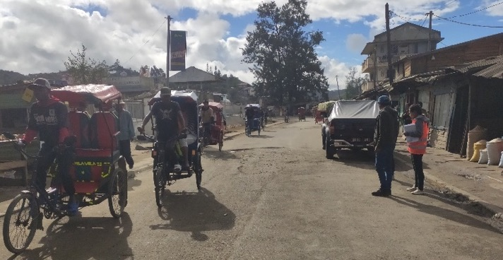
3
Road Fund Study: Objectives

Slide 9
Road Fund Baseline Survey
Objectives
Diagnose the status of the road funds in Africa Define the model for next-generation road funds Provide evidence-based guidelines for transition

Slide 10

4
Timeline & ARMFA collaboration
Timeline: 20 weeks
Start date: 25 August 2025
ARMFA: Coordinator & country focal points

Slide 11
1. Background and Objective of the Assignment
Two decades after the establishment of Second Generation of Road Funds, several critical issues continue to affect their efficiency and long-term sustainability:
Governance gaps persist, including imbalances in board members composition.
The available budgets are insufficient to match the growing volume of roads requiring maintenance resulting in cumulative backlogs.
Road Funds depend primarily on user charges, such as fuel levies and tolls, which are insufficient to effectively respond to the numerous road damages caused by climate change
These issues place Road Funds under continuous stress, making it difficult to plan, prioritize, and implement maintenance activities efficiently and responding to the needs of road users.

Slide 12
2. Design of a Policy Document for Transitioning Roads Funds to the Next Generation
The project has three overarching purposes:
Diagnostic of the current status of 15 Road Funds focusing on governance practices, funding and operations mechanisms, resilience to climate change readiness, and inclusion of gender equity and equality.
Definition of principles and practices of “third-generation” Road that:
implement governance and transparency mechanisms
blend diverse revenue sources for meeting the expected targets on road maintenance
integrate resilience and climate finance are more inclusive.
Develop a policy document, including the key findings, the Next-Generation Road Fund model, the recommendations and an action plan to be submitted to the next Ministerial Transport and Finance meeting which will take in 2026

Slide 13
3. Stakeholders’ Engagement to ensure Project Success and Foster Ownership
A participatory and consultative approach will be implemented to ensure that ARMFA and the selected Road Funds focal points are fully engaged throughout the survey process. To this end, the Experts will:
Establish continuous and effective communication with ARMFA, focal points, and relevant national stakeholders to facilitate collaboration on the project and to ensure timely responses to the requested questions.
If necessary, they will adapt tools and processes based on the quality of data received and response rates.
Provide regular reporting to SSATP-EU and ARMFA on the progress and challenges of the project.
Sharing information with SSATP-EU and ARMFA on the challenges faced by Road Funds but also the best practices applied by the Road Funds and lessons learned.
This approach will:
Enhance information and data quality and sharing for analysis
Build ownership
Ensure that the final recommendations and policy document are aligned with their expectations for transitioning to third-generation Road Funds.

Slide 14
Phase 1. Inception
REVIEW OF EXISTING DOCUMENT
. Legal status of the Road Fund Second generation
. Road Fund annual technical and financial reports
. ARMFA annual reports
. World Bank-SSATP studies
. Reports on the impact of climate change on roads assets
. EU and DFIs studies on transport corridors and regional integration
. Other documents recommended by SSATP-ARMFA
STAKEHOLDER MAPPING
Identification of key institutions for interview:
. ARMFA selected Road Funds
. Non ARMFA members
. Ministries of Finance, Transport/ Public Work
. Donors, Partners, Development Finance Institutions
SURVEY DESIGN AND INTERVIEW GUIDES
AREAS:
. Governance
. Operation
. Finance
. Climate change
. Social inclusion (gender equity-equality)
. Regional integration/transport corridors initiatives
. Policy reform recommendations from Road Funds
INCEPTION REPORT
. Methodology
. Tools for collection of data and analysis
. Engagement approach
. Data risk management
. Confidentiality aspects
. Workplan

Slide 15

Tools for Diagnostic and Analysis
Diagnostic exercise combining primary and secondary data sources.
Primary data will be collected through the survey questionnaires and interviews with Road Fund focal points
The secondary data will be mobilised through the Road Fund annual technical, financial and audit reports, ARMFA annual reports and conference records, World Bank-SSATP and AfDB, reports, TA TRAC database including reports on transport and road maintenance.
To process and analyse the collected data, the experts will use a range of analytical tools, including dashboards (Excel or Power BI), comparative matrices, reliability scoring grids.

Slide 16
Phase 2. Survey Launch and Data Mobilization
STAKEHOLDER ENGAGEMENT
With the support of ARMFA
. Engage country focal points for collaboration leveraging the Nairobi September 2025
. Present the objectives, scope and expected outcomes
. Secure commitment from focal points to support and participate in the survey process.
. Define roles, responsibilities, and expectations from the Focal Points
SURVEY LAUNCH AND DATA MOBILIZATION
. Distribute the questionnaire to participating Road Funds focal point
. Schedule interviews and working sessions with Focal points and concerned Ministries
. Gather relevant information to refine and adjust the methodology.
INTERIM SUMMARY OF SURVEY RESPONSE
. Highlight initial data quality findings
. Identify data gaps
. Define follow-up actions address data gaps

Slide 17
Phase 3. Data Collection and Validation
INFORMATION AND DATA COLLECTION
. Conduct interviews
. Collect questionnaires replies
. Assessment of secondary sources other institutions
. Triangulation to reconstruct missing elements.
GAP IDENTIFICATION AND CONFIDENCE SCORING
. Identify mission or conflicting information and assign a confidence rating to each data point.
. For low-confidence data, conduct interviews or elaborate written queries to Focal Points to minimize gaps.
DATASET AND RELIABILITY MATRIX
. Compile collected data into a dataset
. Elaborate a reliability matrix informing on the level confidence and any outstanding information requests.

Slide 18
Phase 4. Analysis & Synthesis
COMPARATIVE ANALYSIS
. Benchmark Road Funds across key factors: governance structures, funding sources, revenue mechanisms, disbursement models, transparency practices, institutional frameworks, resilience-readiness, equity.
. Typology of Road Funds (e.g., mature vs. emerging funds, single vs. multi-stream revenue).
NEXT-GENERATION BLUEPRINT
. Draft a set of principles and financing options (dedicated resilience lines, blended mechanisms, performance indicators)
. Identify the best practices for dissemination
DRAFT REPORT
Key findings
Analytical report as a key input in SSATP-ARMFA meetings.

Slide 19
Phase 5. Reporting and Dissemination
FINAL REPORT
. Survey data
. Typologies
. Road Funds profiles
. Benchmarking
. Findings
POLICY RECOMMENDATIONS
NEXT GENERATION OF ROAD FUNDS
. Efficient and transparent governance,
. Financial sustainability,
. Cimate resilience,
. Integration of gender equality and social inclusion
DISSEMINATION
. Debriefing sessions with ARMFA and its Road Fund focal points
. Presentation of findings and policy document in the framework of SSATP-EU conferences on Road maintenance

Slide 20
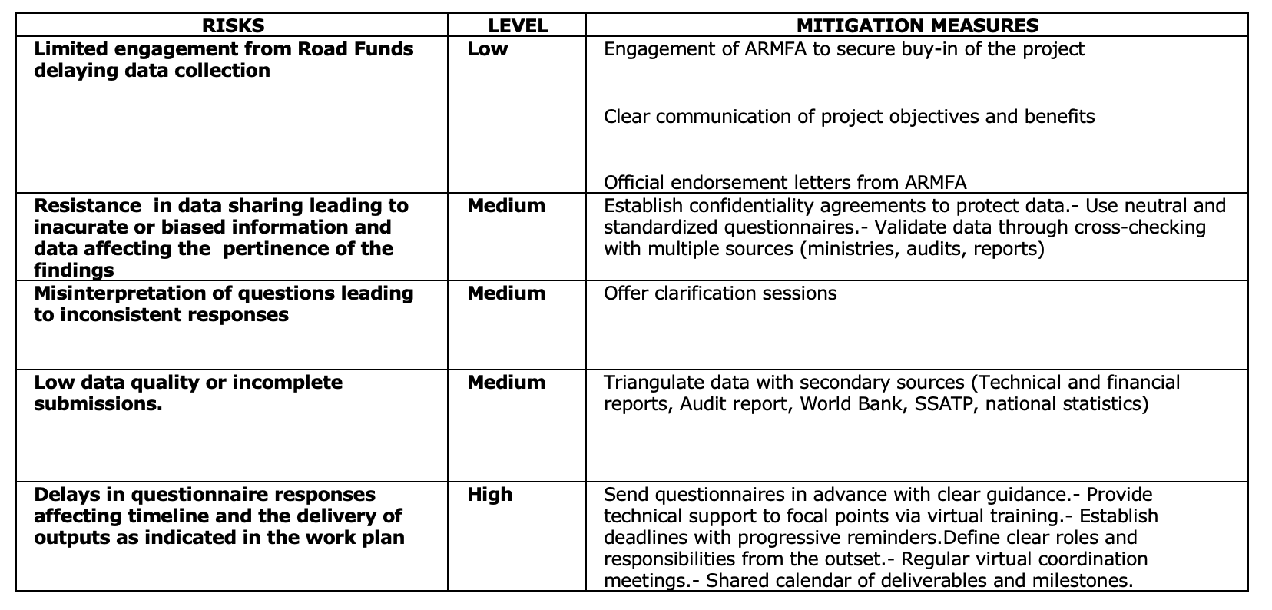
Risks and Mitigation Measures

Slide 21
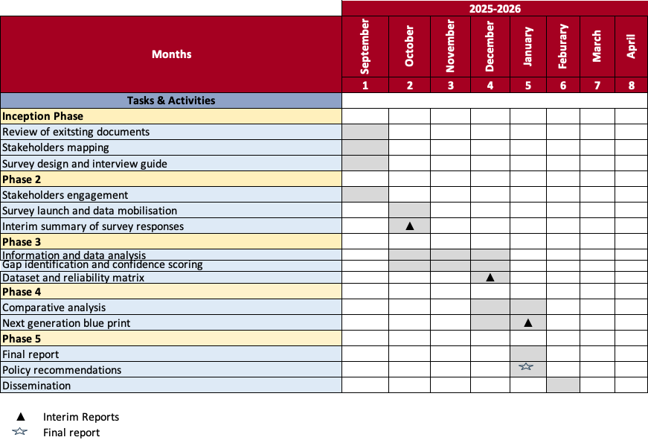
Workplan

Slide 22
Thank you
Technical Assistance to Support the Africa Transport Policy Program (SSATP) Fourth Development Plan (DP4) Implementation
18 September 2025
EC-INTPA/2024/EARP/0021

